Slide 1

DIVINE GRACE COLLEGE OF ARTS, SCIENCE AND TECHNOLOGY
(DGCAST) — GAROUA | GEOGRAPHY DEPARTMENT
UPPER SIXTH ARTS — POPULATION GEOGRAPHY — LESSON 17
Overpopulation, Underpopulation and Optimum Population
Mr KAMDEM EMMANUEL
Geography Teacher — PLEG
Academic Year 2026 / 2027
Notes:
Good morning, class. Today we study Lesson 17: Overpopulation, Underpopulation and Optimum Population.

Slide 2
GEOGRAPHY — UPPER SIXTH ARTS
CLASS INFO
Class, Chapter & Duration
Class | Upper Sixth Arts
Chapter | Module 4: Understanding and managing population dynamics across the world in general and Cameroon in particular
Duration | 2 periods (2 × 50 minutes)
2026 / 2027
DGCAST GAROUA — GEOGRAPHY DEPARTMENT
Mr KAMDEM E. | 2

Slide 3
GEOGRAPHY — UPPER SIXTH ARTS
IDENTIFICATION
Lesson Identification
Topic | Population Growth and Resources
Sub-topic | Population and Resource Relationships
Lesson | Lesson 17: Overpopulation, Underpopulation and Optimum Population
Notions / Concepts | Overpopulation, underpopulation, optimum population, output per person, indicators.
Syllabus focus | Meaning and situations; indicators and measurement; causes, consequences and solutions.
Competence | Learners are able to identify over-, under- and optimum population and suggest solutions.
2026 / 2027
DGCAST GAROUA — GEOGRAPHY DEPARTMENT
Mr KAMDEM E. | 3

Slide 4
GEOGRAPHY — UPPER SIXTH ARTS
OBJECTIVES
Learning Objectives
By the end of the lesson, the learner should be able to:
Define over-, under- and optimum population.
Give indicators and examples of each.
Explain causes, consequences and solutions.
2026 / 2027
DGCAST GAROUA — GEOGRAPHY DEPARTMENT
Mr KAMDEM E. | 4

Slide 5
GEOGRAPHY — UPPER SIXTH ARTS
RECALL
Recall
Carrying capacity is the limit of support.
Technology can raise production.
2026 / 2027
DGCAST GAROUA — GEOGRAPHY DEPARTMENT
Mr KAMDEM E. | 5

Slide 6
GEOGRAPHY — UPPER SIXTH ARTS
REAL-LIFE SITUATION
Real-Life Situation
In some villages of the West Region, fields are tiny and young people leave. In the East, large forests have few people and roads, and many resources are not used.
2026 / 2027
DGCAST GAROUA — GEOGRAPHY DEPARTMENT
Mr KAMDEM E. | 6
Notes:
Read the situation slowly, twice.

Slide 7
GEOGRAPHY — UPPER SIXTH ARTS
REAL-LIFE SITUATION
Situation — Question 1
What is the problem in the situation?
2026 / 2027
DGCAST GAROUA — GEOGRAPHY DEPARTMENT
Mr KAMDEM E. | 7

Slide 8
GEOGRAPHY — UPPER SIXTH ARTS
REAL-LIFE SITUATION
Answer
Some areas have too many people and others too few for their resources.
2026 / 2027
DGCAST GAROUA — GEOGRAPHY DEPARTMENT
Mr KAMDEM E. | 8

Slide 9
GEOGRAPHY — UPPER SIXTH ARTS
REAL-LIFE SITUATION
Situation — Question 2
What is the West village situation called?
2026 / 2027
DGCAST GAROUA — GEOGRAPHY DEPARTMENT
Mr KAMDEM E. | 9

Slide 10
GEOGRAPHY — UPPER SIXTH ARTS
REAL-LIFE SITUATION
Answer
Overpopulation (local).
2026 / 2027
DGCAST GAROUA — GEOGRAPHY DEPARTMENT
Mr KAMDEM E. | 10

Slide 11
GEOGRAPHY — UPPER SIXTH ARTS
REAL-LIFE SITUATION
Situation — Question 3
What is the East situation called?
2026 / 2027
DGCAST GAROUA — GEOGRAPHY DEPARTMENT
Mr KAMDEM E. | 11

Slide 12
GEOGRAPHY — UPPER SIXTH ARTS
REAL-LIFE SITUATION
Possible Answer
Underpopulation.
2026 / 2027
DGCAST GAROUA — GEOGRAPHY DEPARTMENT
Mr KAMDEM E. | 12

Slide 13
GEOGRAPHY — UPPER SIXTH ARTS
JUSTIFICATION
Justification of the Lesson
This lesson helps us to understand the balance between people and resources.
2026 / 2027
DGCAST GAROUA — GEOGRAPHY DEPARTMENT
Mr KAMDEM E. | 13

Slide 14
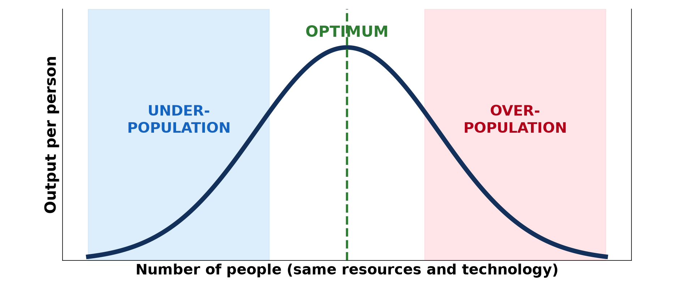
GEOGRAPHY — UPPER SIXTH ARTS
I. THE CONCEPTS
Activity 1
Output per person and population size.
2026 / 2027
DGCAST GAROUA — GEOGRAPHY DEPARTMENT
Mr KAMDEM E. | 14
Notes:
Without the projector: draw the curve.

Slide 15
GEOGRAPHY — UPPER SIXTH ARTS
I. THE CONCEPTS
Activity 1: Question
What is optimum population?
2026 / 2027
DGCAST GAROUA — GEOGRAPHY DEPARTMENT
Mr KAMDEM E. | 15

Slide 16
GEOGRAPHY — UPPER SIXTH ARTS
I. THE CONCEPTS
Answer
The number of people that gives the highest output per person.
2026 / 2027
DGCAST GAROUA — GEOGRAPHY DEPARTMENT
Mr KAMDEM E. | 16

Slide 17

GEOGRAPHY — UPPER SIXTH ARTS
II. OVERPOPULATION
Activity 2
A crowded market.
2026 / 2027
DGCAST GAROUA — GEOGRAPHY DEPARTMENT
Mr KAMDEM E. | 17
Notes:
Without the projector: list indicators.

Slide 18
GEOGRAPHY — UPPER SIXTH ARTS
II. OVERPOPULATION
Activity 2: Question
Give two indicators of overpopulation.
2026 / 2027
DGCAST GAROUA — GEOGRAPHY DEPARTMENT
Mr KAMDEM E. | 18

Slide 19
GEOGRAPHY — UPPER SIXTH ARTS
II. OVERPOPULATION
Answer
Unemployment and food shortages (also slums, land shortage, emigration).
2026 / 2027
DGCAST GAROUA — GEOGRAPHY DEPARTMENT
Mr KAMDEM E. | 19

Slide 20

GEOGRAPHY — UPPER SIXTH ARTS
II. OVERPOPULATION
Activity 3
Dry, degraded land.
2026 / 2027
DGCAST GAROUA — GEOGRAPHY DEPARTMENT
Mr KAMDEM E. | 20
Notes:
Without the projector: discuss the Sahel.

Slide 21
GEOGRAPHY — UPPER SIXTH ARTS
II. OVERPOPULATION
Activity 3: Question
How can overpopulation damage the environment?
2026 / 2027
DGCAST GAROUA — GEOGRAPHY DEPARTMENT
Mr KAMDEM E. | 21

Slide 22
GEOGRAPHY — UPPER SIXTH ARTS
II. OVERPOPULATION
Answer
Overgrazing, deforestation and soil erosion.
2026 / 2027
DGCAST GAROUA — GEOGRAPHY DEPARTMENT
Mr KAMDEM E. | 22

Slide 23
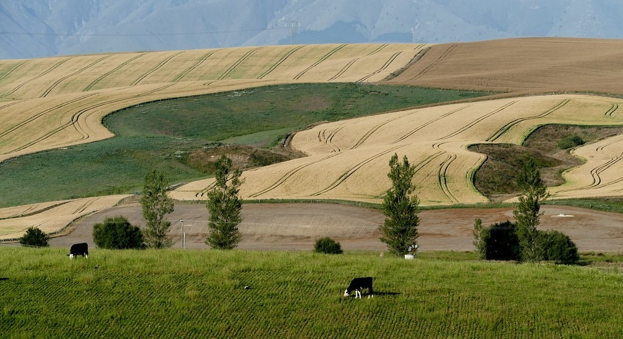
GEOGRAPHY — UPPER SIXTH ARTS
III. UNDERPOPULATION
Activity 4
Large wheat fields in New Zealand.
2026 / 2027
DGCAST GAROUA — GEOGRAPHY DEPARTMENT
Mr KAMDEM E. | 23
Notes:
Without the projector: find Canada and Australia.

Slide 24
GEOGRAPHY — UPPER SIXTH ARTS
III. UNDERPOPULATION
Activity 4: Question
Why do some countries have too few people?
2026 / 2027
DGCAST GAROUA — GEOGRAPHY DEPARTMENT
Mr KAMDEM E. | 24

Slide 25
GEOGRAPHY — UPPER SIXTH ARTS
III. UNDERPOPULATION
Answer
Rich resources but not enough workers to use them.
2026 / 2027
DGCAST GAROUA — GEOGRAPHY DEPARTMENT
Mr KAMDEM E. | 25

Slide 26

GEOGRAPHY — UPPER SIXTH ARTS
IV. SOLUTIONS
Activity 5
Planting trees.
2026 / 2027
DGCAST GAROUA — GEOGRAPHY DEPARTMENT
Mr KAMDEM E. | 26
Notes:
Without the projector: list solutions.

Slide 27
GEOGRAPHY — UPPER SIXTH ARTS
IV. SOLUTIONS
Activity 5: Question
Give two solutions to overpopulation.
2026 / 2027
DGCAST GAROUA — GEOGRAPHY DEPARTMENT
Mr KAMDEM E. | 27

Slide 28
GEOGRAPHY — UPPER SIXTH ARTS
IV. SOLUTIONS
Answer
Family planning and better farming (also industry, migration, resettlement).
2026 / 2027
DGCAST GAROUA — GEOGRAPHY DEPARTMENT
Mr KAMDEM E. | 28

Slide 29
GEOGRAPHY — UPPER SIXTH ARTS
BOARD SUMMARY
Overpopulation, Underpopulation and Optimum Population
Topic: Population Growth and Resources
Sub-topic: Population and Resource Relationships
Lesson 17: Overpopulation, Underpopulation and Optimum Population
2026 / 2027
DGCAST GAROUA — GEOGRAPHY DEPARTMENT
Mr KAMDEM E. | 29
Notes:
Learners copy the board summary now. Give them enough time for each slide.

Slide 30
GEOGRAPHY — UPPER SIXTH ARTS
BOARD SUMMARY
I. Definitions
Overpopulation: It is when there are too many people for the resources and technology of an area.
Underpopulation: It is when there are too few people to use the resources fully.
Optimum population: It is the population that gives the highest standard of living.
2026 / 2027
DGCAST GAROUA — GEOGRAPHY DEPARTMENT
Mr KAMDEM E. | 30

Slide 31
GEOGRAPHY — UPPER SIXTH ARTS
BOARD SUMMARY
II. Indicators and Causes (1/2)
A. Overpopulation: Indicators are unemployment, hunger, slums and emigration. Causes are rapid growth and poor technology.
B. Underpopulation: Indicators are unused resources, labour shortages and immigration. Canada and Australia are examples.
2026 / 2027
DGCAST GAROUA — GEOGRAPHY DEPARTMENT
Mr KAMDEM E. | 31

Slide 32
GEOGRAPHY — UPPER SIXTH ARTS
BOARD SUMMARY
II. Indicators and Causes (2/2)
C. Measurement: Output per person and standard of living are compared with population. The optimum changes with technology.
2026 / 2027
DGCAST GAROUA — GEOGRAPHY DEPARTMENT
Mr KAMDEM E. | 32

Slide 33
GEOGRAPHY — UPPER SIXTH ARTS
BOARD SUMMARY
III. Consequences and Solutions (1/2)
A. Consequences of overpopulation: Poverty, conflict and environmental damage increase. People emigrate.
B. Consequences of underpopulation: Resources are wasted and services are costly. Governments encourage immigration.
2026 / 2027
DGCAST GAROUA — GEOGRAPHY DEPARTMENT
Mr KAMDEM E. | 33

Slide 34
GEOGRAPHY — UPPER SIXTH ARTS
BOARD SUMMARY
III. Consequences and Solutions (2/2)
C. Solutions: Family planning, better farming and industry help overpopulated areas. Immigration and investment help underpopulated areas.
2026 / 2027
DGCAST GAROUA — GEOGRAPHY DEPARTMENT
Mr KAMDEM E. | 34

Slide 35
GEOGRAPHY — UPPER SIXTH ARTS
FORMATIVE EVALUATION
Formative Evaluation 1
Define optimum population.
2026 / 2027
DGCAST GAROUA — GEOGRAPHY DEPARTMENT
Mr KAMDEM E. | 35

Slide 36
GEOGRAPHY — UPPER SIXTH ARTS
FORMATIVE EVALUATION
Expected Answer
The population that gives the highest standard of living.
2026 / 2027
DGCAST GAROUA — GEOGRAPHY DEPARTMENT
Mr KAMDEM E. | 36

Slide 37
GEOGRAPHY — UPPER SIXTH ARTS
FORMATIVE EVALUATION
Formative Evaluation 2
Give two indicators of overpopulation.
2026 / 2027
DGCAST GAROUA — GEOGRAPHY DEPARTMENT
Mr KAMDEM E. | 37

Slide 38
GEOGRAPHY — UPPER SIXTH ARTS
FORMATIVE EVALUATION
Expected Answer
Unemployment and food shortages (also slums, emigration).
2026 / 2027
DGCAST GAROUA — GEOGRAPHY DEPARTMENT
Mr KAMDEM E. | 38

Slide 39
GEOGRAPHY — UPPER SIXTH ARTS
REMEDIATION
Remediation
Fill in the blanks:
Too few people for the resources is ______.
The best balance of people and resources is ______ population.
Canada is an example of ______.
2026 / 2027
DGCAST GAROUA — GEOGRAPHY DEPARTMENT
Mr KAMDEM E. | 39
Notes:
Answers: 1. underpopulation 2. optimum 3. underpopulation

Slide 40
GEOGRAPHY — UPPER SIXTH ARTS
HOMEWORK
Homework
Is Cameroon over-, under- or optimally populated? Write a paragraph with evidence.
This prepares Lesson 18: Malthus and Boserup.
2026 / 2027
DGCAST GAROUA — GEOGRAPHY DEPARTMENT
Mr KAMDEM E. | 40
Notes:
This homework prepares the next lesson.

Slide 41
GEOGRAPHY — UPPER SIXTH ARTS
BILINGUAL GAME
Bilingual Game (Jeu Bilingue)
English | Français
Overpopulation | La surpopulation
Underpopulation | Le sous-peuplement
Optimum | L'optimum
Standard of living | Le niveau de vie
Indicator | L'indicateur
Solution | La solution
2026 / 2027
DGCAST GAROUA — GEOGRAPHY DEPARTMENT
Mr KAMDEM E. | 41
Notes:
Say the English word; learners give the French word, then the reverse.

Slide 42
GEOGRAPHY — UPPER SIXTH ARTS
LOGBOOK
Official Logbook (1/2)
Module / Topic | Population Growth and Resources
Lesson Title | Lesson 17: Overpopulation, Underpopulation and Optimum Population
Expected Learning Outcomes | Define over-, under- and optimum population. Give indicators and examples of each. Explain causes, consequences and solutions.
Competence | Learners are able to identify over-, under- and optimum population and suggest solutions.
2026 / 2027
DGCAST GAROUA — GEOGRAPHY DEPARTMENT
Mr KAMDEM E. | 42

Slide 43
GEOGRAPHY — UPPER SIXTH ARTS
LOGBOOK
Official Logbook (2/2)
Matter Taught | I. Definitions: Overpopulation, Underpopulation, Optimum population; II. Indicators and Causes: Overpopulation, Underpopulation, Measurement; III. Consequences and Solutions: Consequences of overpopulation, Consequences of underpopulation, Solutions.
Evaluation | Formative evaluation (3 questions) and remediation exercise.
Homework | Is Cameroon over-, under- or optimally populated? Write a paragraph with evidence.
Enrolment / Present / Absent | ____ / ____ / ____
Achievement | To be completed by the teacher after the lesson.
2026 / 2027
DGCAST GAROUA — GEOGRAPHY DEPARTMENT
Mr KAMDEM E. | 43

Slide 44
GEOGRAPHY — UPPER SIXTH ARTS
TEACHER'S NOTE
Teacher's Note
Timing: Set-up, recall 8 min | Situation 8 min | 5 activities 30 min | Board summary (copying) 30 min | Evaluation, remediation 10 min | Homework, logbook 9 min | Spare 5 min
2026 / 2027
DGCAST GAROUA — GEOGRAPHY DEPARTMENT
Mr KAMDEM E. | 44

Slide 45
GEOGRAPHY — UPPER SIXTH ARTS
REFERENCES
References
National Geography Syllabus, Sixth Forms (Lower & Upper Sixth), MINESEC/IGE/IP-SS, August 2019 — Module 4 (Population Geography).
Photo, Activity 2: “Wax market” by zouzouwizman, CC BY 2.0, via Flickr (https://www.flickr.com/photos/61111202@N00/12129001)
Photo, Activity 3: “Imagine a world without trees” by aloshbennett, CC BY 2.0, via Flickr (https://www.flickr.com/photos/13203757@N00/3480223314)
Photo, Activity 4: “Wheat fields. New Zealand.” by Bernard Spragg, CC0 1.0, via Flickr (https://www.flickr.com/photos/88123769@N02/24607172362)
Photo, Activity 5: “Haitian Students Breathe New Life into Depleted Pine Forest” by United Nations Photo, CC BY-NC-ND 2.0, via Flickr (https://www.flickr.com/photos/35483578@N03/5860275159)
Diagrams and animations: drawn for this lesson (DGCAST Geography Department).
2026 / 2027
DGCAST GAROUA — GEOGRAPHY DEPARTMENT
Mr KAMDEM E. | 45

